Slide 1
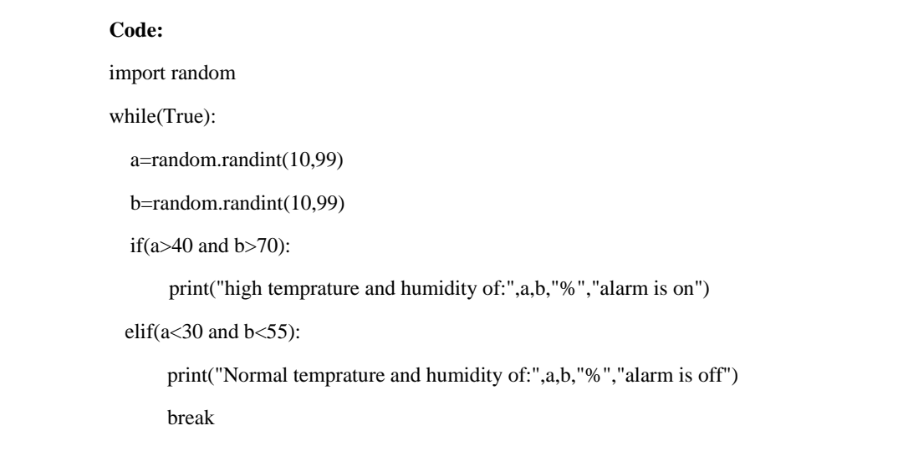
ASSIGNMENT NO -2
Project Name : REAL-TIME RIVER WATER QUALITY MONITORING AND CONTROL SYSTEM
Batch Number: B5-51ME
Assignment Topic : Assignment on temperature and humidity sensing and alarm automation using python
TEAM MEMBERS
Team lead : M.Priyadharshini Member-1 : E.Jananipriya Member-2 : M.sudarvizhi Member-3 : B.Sangeetha

Slide 2
